Slide 1
Ellipse Fitting Using LDLT Decomposition and Generalized Eigenvalue Analysis
Comparison between matlab eig(S,C) and custom LDLT based solver

Slide 2
Ellipse Fitting Background
The objective is to fit the ellipse to 2D data points using the general conic equation of the ellipse fitting.
F(x, y) = ax^2 + bxy + cy^2 + dx + ey + f = 0
Where the parameters a,b,c,d,ef are linear.
For the conic to represent an ellipse, the parameters must satisfy the equation.
b^2 – 4 * a * c < 0

Slide 3
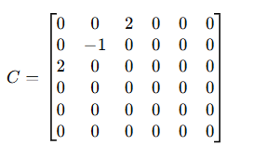
Ellipse Fitting Background
To help solve the generalized eigenvalue problem:
Sa = λCa
The quadratic constraint is expressed as the matrix C:
Where S is the scatter matrix:
S = DT * D
In order to find the scatter matrix, the algebraic distance F(x,y) of any point (x,y) is minimized using least squares to give the design matrix D. :
D = [x^2, xy, y^2,x , y, 1]

Slide 4
LDLT Decomposition
In order to use the LDLT factorization to find the solution for the generalized eigenvalue problem, the constraint matrix C must be factorized:
C = LDLT
Which is reduced to as:
Sa = λLDLT a
The inverse of L is then multiplied by on both sides of the equation to help simplify the equation into the standard eigenvalue problem.
L^ −1* Sa = λDLT a
A new variable (z) is then substituted to recover the eigenvectors of variable (a) of the original problem.
z = L^T a => (L ^−T )z = a => a = L^ −T z
Which will give the following equation: L^ −1(SL^−T z) = λDz

Slide 5
LDLT Decomposition
The equation is then normalized, which is done by multiplying both sides of the equation by the inverse of D.
(D^−1L^ −1 )SL^−T z = λ(D^−1D)z
Which is reduced to:
(D^−1L^ −1 )SL^−T z = λz

Slide 6

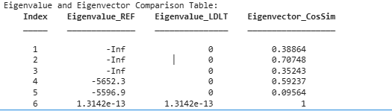
MATLAB IMPLEMENTATIONS

